Slide 1
Work Session 5: Establish Implementation and Maintenance Procedures
Planning for Hazards Working Group
[DATE]
Images and logos as appropriate

Slide 2
Meeting Overview
Discuss final draft implementation tools
Discuss approval and/or adoption procedures
Establish protocols for ongoing administration and maintenance
Discuss future risk reduction projects
Dismiss the Working Group!
Have fun

Slide 3
Where Are We Now?
12 Months
Up to five work sessions:
Introduction, assess vulnerability
Planning strategies and identifying planning tools
Prioritizing planning tools
Refining draft planning tools
Implementation and maintenance
Identify and Prioritize Implementation Tools
Develop and Refine Implementation Tools
Implementation and Maintenance

Slide 4
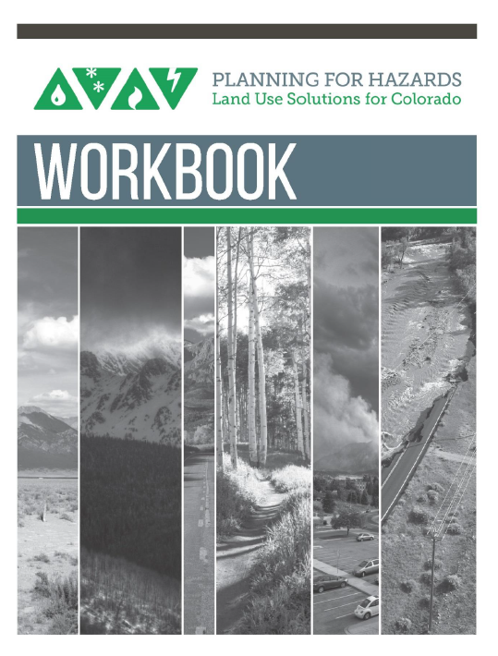
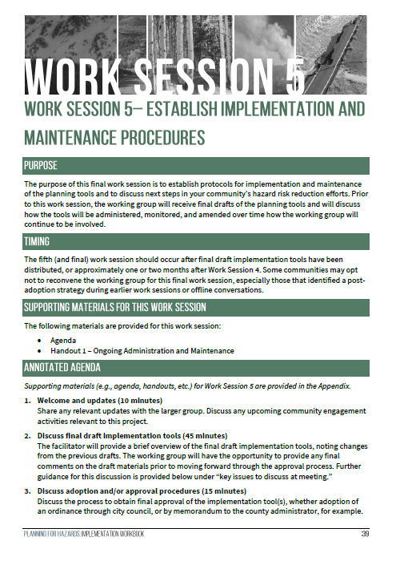
The Planning for Hazards Workbook

Slide 5
Discuss Final Draft Implementation Tools
Slides on draft implementation tools as necessary

Slide 6
Public feedback
Include any initial public feedback received on the tools (if applicable)

Slide 7
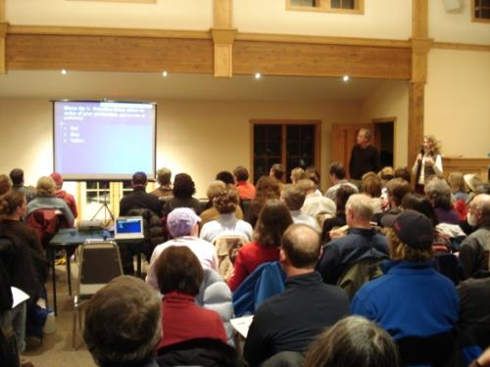
Upcoming Engagement Opportunities
Informational meetings
Surveys
Study session/work session
Media outreach
City/town website
Listserv
Interviews
Mailings

Slide 8
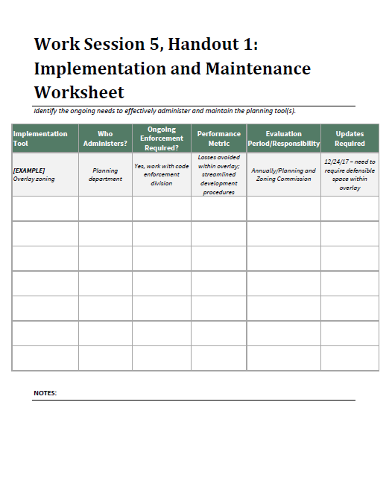
Administration and Maintenance
For each tool, consider the next few slides

Slide 9
Who Administers the Tool[s]

Slide 10
Is Ongoing Enforcement Required?

Slide 11
Performance Metrics?

Slide 12
Who Evaluates, and When?

Slide 13
Are There Updates Required?

Slide 14
Discuss Future Risk Reduction Projects
Will the Working Group meet again? When?
Discuss implementation of the tools.
Discuss other related projects relevant to the Working Group.

Slide 15
Thank You
Insert contact info
Images and logos as appropriate

