Slide 1
Work Session 2: Assess Capabilities and Develop Planning Strategies
Planning for Hazards Working Group
[DATE]
Images and logos as appropriate

Slide 2
Meeting Overview
Recap Work Session 1
Discuss draft HIRA or local risk assessment [if applicable]
Review community capabilities
Discuss initial planning implementation strategies
Next steps/final discussion
Have fun

Slide 3
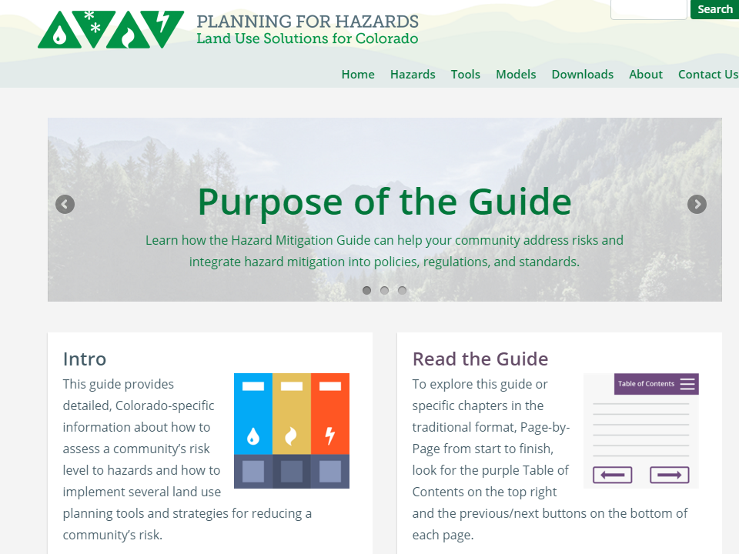
www.planningforhazards.com

Slide 4
Where Are We Now?
12 Months
Up to five work sessions:
Introduction, assess vulnerability
Planning strategies and identifying planning tools
Prioritizing planning tools
Refining draft planning tools
Implementation and maintenance
Identify and Prioritize Implementation Tools
Develop and Refine Implementation Tools
Implementation and Maintenance

Slide 5
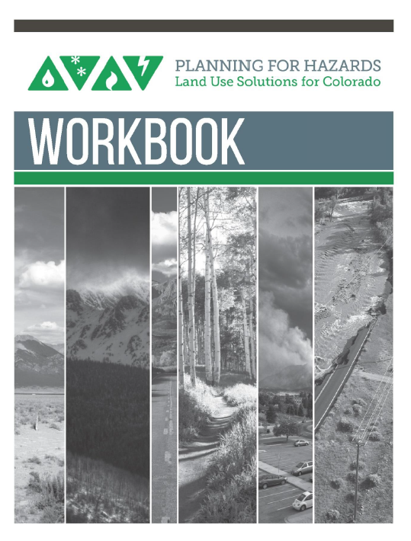
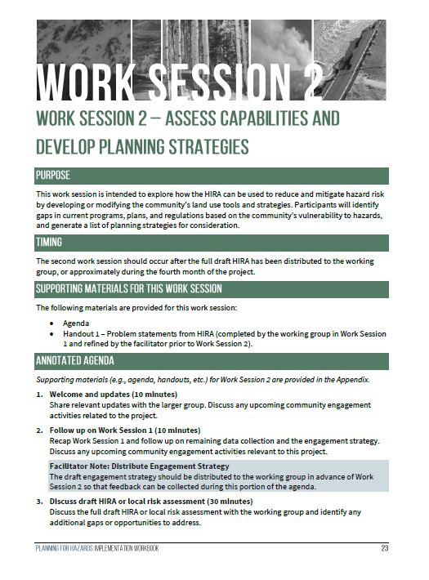
The Planning for Hazards Workbook

Slide 6
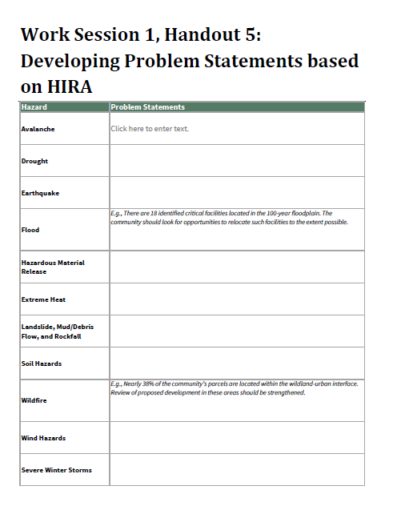
Review Problem Statements
Recap the problem statements developed in WS1

Slide 7
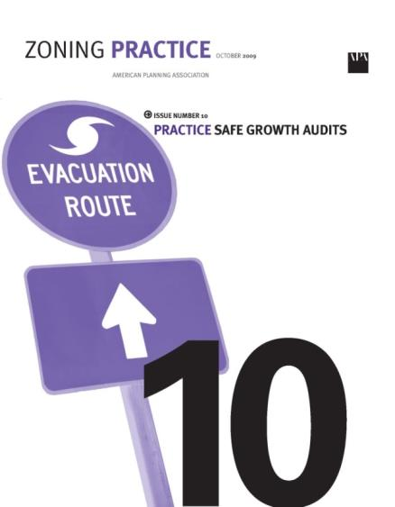
Community Capabilities Assessment
Assess existing capabilities available to reduce long-term vulnerability
Identify gaps in capabilities that could be addressed
Incorporate APA Safe Growth Audit approach
Consider impact of existing policies, ordinances, and plans on community safety
Types of Capabilities
Planning & Regulatory
Administrative & Technical
Financial
Education & Outreach

Slide 8
Key Considerations
For all regulatory tools, consider:
Have we mapped the hazard/risk sufficiently to regulate by?
Will they apply [town/city] wide?
Will they apply to existing development?
What are the size thresholds for applicability?
Are there different levels of risk?
Can we administer the tool in-house?
How much burden on staff vs. applicant?

Slide 9
Planning Tool Profiles (from the Guide)
Comprehensive Plan
Climate Plan
Community Wildfire Protection Plan
Hazard Mitigation Plan
Parks and Open Space Plan
Pre-Disaster Planning
Community Rating System
Density Bonus
Development Agreement
Transfer of Development Rights
1041 Regulations
Cluster Subdivision
Conservation Easement
Land Acquisition
Overlay Zoning
Stream Buffers and Setbacks
Stormwater Ordinance
Site-Specific Assessment
Subdivision and Site Design Standards
Use-Specific Standards
Building Code
Critical Infrastructure Protection
Wildland-Urban Interface (WUI) Code
Application Submittal Requirements
Post-Disaster Building Moratorium

Slide 10
Tool Descriptions
[if the community wants to highlight tools that rise to the top for consideration, then describe those tools in a few slides]

Slide 11
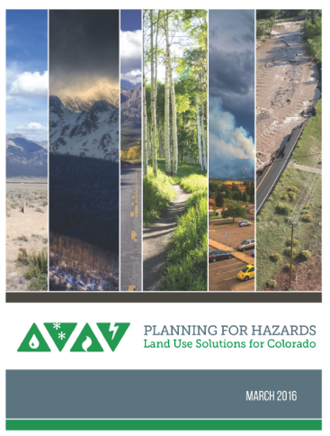
Next Steps
Work Session 3 – [insert date]

Slide 12
Thank You
Insert contact info
Images and logos as appropriate

